Slide 1
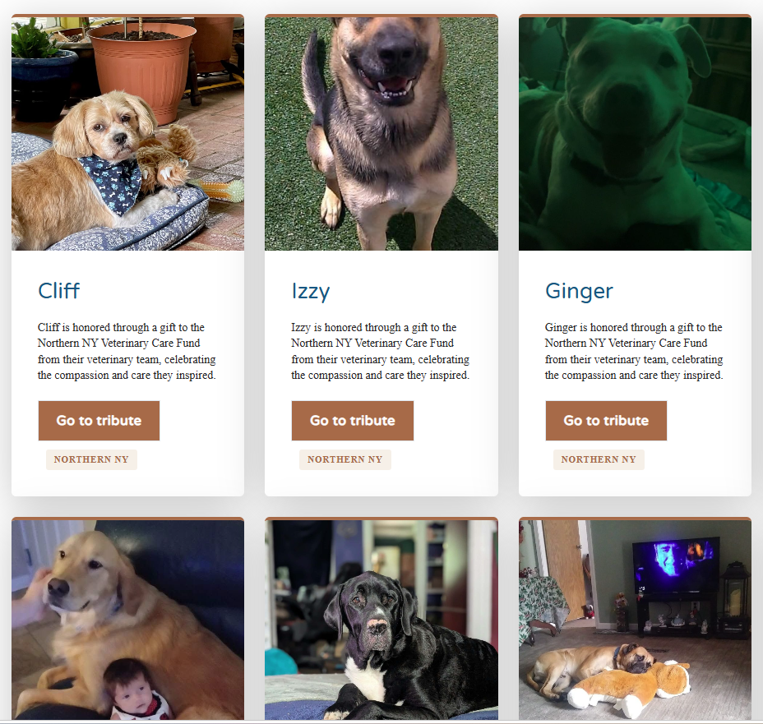

Memorial giving for veterinary teams
FOR ANIMALS TOGETHER
Honor a patient.
Help care for the next one.
NYSVMS Foundation · New York State Veterinary Care Funds
Notes:
Introduce yourself as your region's representative. This takes about ten minutes. The one thing to leave the room with: when a patient dies, your practice can make a gift in that pet's name, and the family can add their pet to the Legacy Wall.

Slide 2

Your team already marks the loss of a patient.
THE MOMENT
Memorial giving adds a small gift in the pet's name to that moment,
The client may later make a larger gift that pays for care for other animals in your region.
NYSVMS Foundation · New York State Veterinary Care Funds
Notes:
Ask the room how their practice handles a patient death today. Most already send a sympathy card. Memorial giving builds on what they already do; it is not a new routine.

Slide 3
Several State VMAs have found that pet owners subsequently donate substantial sums to the fund
These owners are the primary source of funding
WHERE THE GIFT GOES
Your regional fund
Care for animals in need
A tax-deductible gift
Each gift goes to the Veterinary Care Fund for your practice's region.
The NYSVMS Foundation is a 501(c)(3) nonprofit, and every gift gets a receipt.
The funds make grants that help families afford veterinary care for their pets.
NYSVMS Foundation · New York State Veterinary Care Funds
Notes:
The Veterinary Care Funds are regional. A gift made by a practice goes to the fund for that practice's region, so the money comes back to animals in the same community. If anyone asks about grant details, point them to the Foundation site or the NYSVMS office at (518) 869-7867.

Slide 4
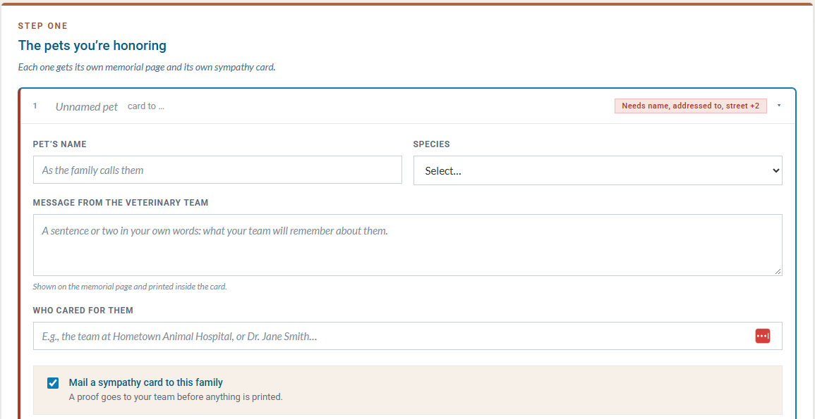
Three steps, one gift.
HOW IT WORKS
1
Sign in with your work email
Your hospital and its regional fund are filled in for you. No password.
2
Add the pets, make one gift
Each pet gets its own memorial page. Tick the box and we mail the family a sympathy card after your team sees a proof.
3
Pass each family their link
Copy the links, or have each one emailed to you with a draft to forward.
NYSVMS Foundation · New York State Veterinary Care Funds
Notes:
Everything happens at remember.nysvms.org. The screen on the right is the first step: the pet's name, a message from the team, who cared for them, and a box to mail a sympathy card. Sign-in is a link emailed to a work address; it keeps the practice signed in for 30 days on that device. A practice in a hurry can continue without signing in, and NYSVMS staff confirm with the practice before any card is printed. Nothing goes to the family automatically: the practice passes on each family's link, so it stays in control of what the client hears and when.

Slide 5
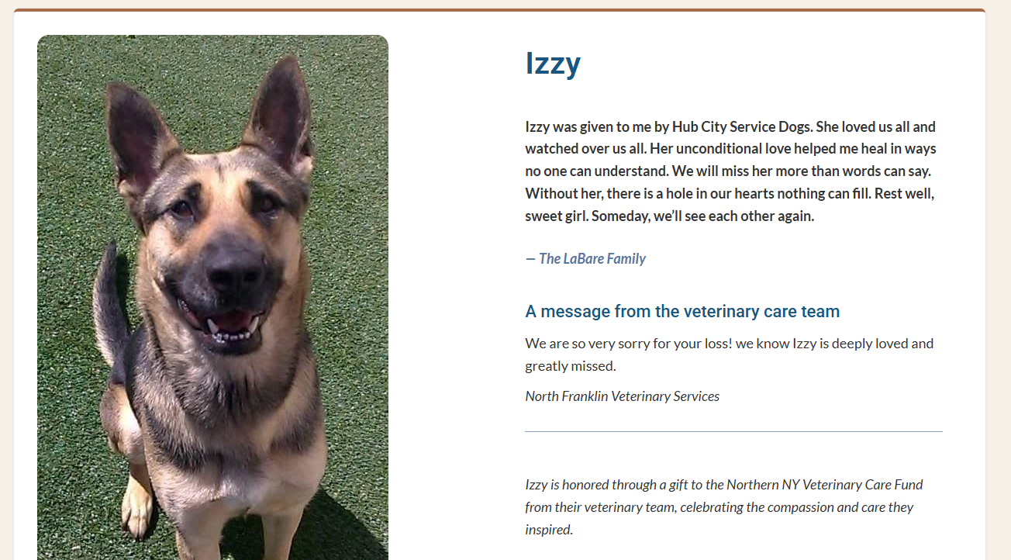
A tribute the family writes, in their own time.
WHAT THE FAMILY SEES
A private link. It does not expire. The family comes back to it when they are ready.
Their photo and words. They add a picture and their own tribute.
A choice to give. If they want, they can add a gift of their own.
NYSVMS Foundation · New York State Veterinary Care Funds
Notes:
This is the live Legacy Wall. Every card here was added with the family's approval. The wall can be filtered by hospital or by regional fund, so a practice can see all of its own patients in one place. Families are never rushed: the link has no deadline.

Slide 6
Your client stays your client.
PRIVACY
Nothing public without consent
Addresses are not kept
Appeals only if they opt in
If we mail a card, we do not keep the name or address afterward or use it for marketing.
No information appears on the Legacy Wall until the pet owner approves it.
A family hears from us again only if they choose to, and no more than twice a year.
NYSVMS Foundation · New York State Veterinary Care Funds
Notes:
This is usually the first question practice owners ask. The short answer: the Foundation treats these families as the practice's clients. Nothing goes on the wall without the owner's approval, card addresses are not retained, and a family only gets further appeals if they give or opt in, at most twice a year.

Slide 7
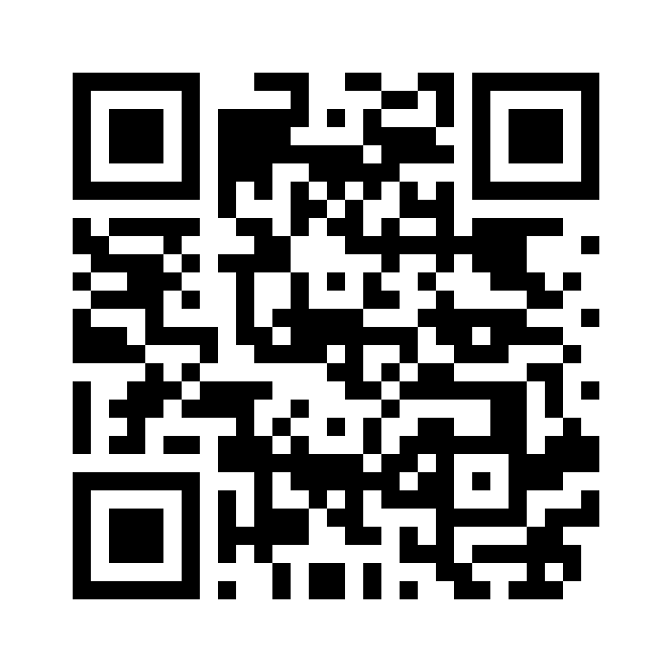
Start with your next patient.
GET STARTED
Submit memorials
remember.nysvms.org
See the Legacy Wall
nysvms.org/foundation/legacy-honorees
Questions
NYSVMS office, (518) 869-7867
NYSVMS Foundation · New York State Veterinary Care Funds
Notes:
Hand out the flyer now. Ask each practice to pick one person who will own memorial giving. Close by thanking them: every gift stays in this region and helps another family afford care.

